Slide 1
Self Defense Concepts
Shoshin Ryu Nationals
Boise 2015

Slide 2
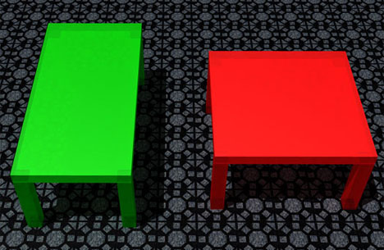
What do you see?

Slide 3
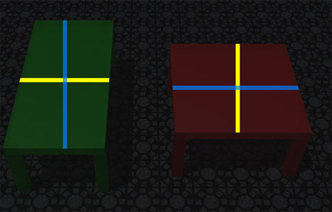
The dimensions of the tables are the same.

Slide 4
What we see - it is real?
How we viewed the previous picture affects what we think. Our minds are fooled, so our thoughts/decisions can be in error.
Perhaps now we can be more open to some things we can learn about self defense that can help us move from violence to harmony better.

Slide 5
SR is not just Self Defense
This talk is about self defense. However, SR is not just this. It is about being responsible for your happiness and harmony.
Self defense is returning a chaotic situation to a harmonious one. Mediations is the same!
Keep yourself in balance.
Takeda Sokaku Sensei, founder of Daito Ryu…
See the violence and the love in the martial arts.
Every blossom is perfect as it is.

Slide 6
Fighting
Marital artist are often fighters training fighters to fight other fighters. Not dealing with self defense. BJJ, karate, kick boxing, any sport -combative art. The idea is that two folks square off against each other. This is not self defense it is fighting.
This is fighting and fighting is illegal. Doesn’t matter who threw the first strike.
SR is different - it attempts to look at how predators and perpetrators approach their targets and deal with them. Restore Harmony.

Slide 7
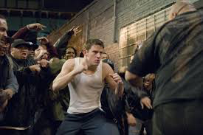
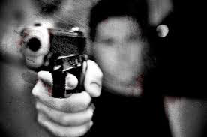
Model One:
Violence: social vs asocial
Social: fighting
bar fights
saving face or rep
dominance
talk your way out; “I’m sorry”
Asocial:
mugging
resource predator
process predator
can’t talk your way out

Slide 8
Social Violence
Status seeking - ‘who you looking at?’ Consider responding ‘just zoning out sorry, pulled a double last night. How are you doing?’ Don’t give anything to push against.
Attack is ritualized
Witnesses wanted
Gang/group: vs. outsiders, begging won’t help. Vietnam - ‘gook’ make the other side less human, subhuman, worthless.
soccer game in Europe
take control - act crazy, talk to god, run, attack.

Slide 9
Asocial Violence
planned attacks - it is about winning, victim is resource, predator pick time and place
remote, no witnesses
attack may be blitz, power threat (weapon), sweet talk/charm person away from group
can’t be trusted
mortality rate urban vs rural = 17 x’s
wants you to worry about being hurt
Where do robberies/muggings take place?

Slide 10
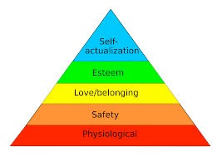
Model Two:
Maslow Hierarchy of Needs
Maslow’s hierarchy of Needs
Robbery for food or drugs - needs
Social Violence - love, belonging
Serial rapists & murderers - SA

Slide 11
Prepare
Awareness
Don’t be where trouble happens
Heiho:
voice
hostage situation - child
expect the unexpected
Physical fitness
Waza -train till you can’t do it wrong
Keep mind your unaltered
Know what criminals are willing to do

Slide 12
Reminder
Amateurs train till they get it right once. Pros train till they can’t get it wrong.
Amateurs fight the attacker’s body. Pros fight the attacker’s mind.
It is ok to be afraid, to get angry at the attacker - focus your energy at that person
Focus on doing damage so you can return to harmonious state
if in control limit chaos, if losing create chaos

Slide 13
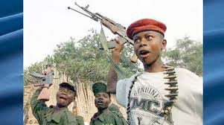
Capacity vs. Capability
one is what you can do
one is what you are willing to do
Until you are in a situation don’t limit yourself
Consider a 25 yo male coming at you with a knife to stab you.
Consider a pregnant lady coming at you with a knife to stab you.
Consider a 10 yo coming at you with a knife to stab you.
What is different?

Slide 14
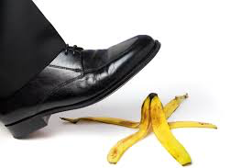
4 Elements of Situation
YOU
Attacker(s)
Environment
Luck

Slide 15
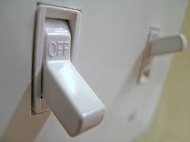
Situation
Be nice till it is time not to be nice
Walk away
Learn to flip the switch and go
Solve the problem
Be quick and efficient
Never never give up
Focus

Slide 16
Situation
Don’t be there but if you are then don’t wobble - act
Escape, run
de-escalate
know yourself
know your environment
know the threat

Slide 17
Adrenaline dump
Adrenaline acts on body to increase strength, take in more light, focus, have single emotion, increase HR/RR dominate.
It helps if you are untrained.
If you are trained it doesn’t help
You lose peripheral vision, lose fine motor control,
Causes freeze, flight or fight
Mediation can decrease - zazen or kata as moving meditation

Slide 18
Freezing
Understand when civilized rules do and don’t apply
Freezing is normal part of reptilian brain
everyone freezes to some degree
SWAT members
The more unexpected the attack the more the brain will freeze

Slide 19
Training to Breaking the Freeze
Do unpleasant things first
Jump into cold water without waiting or working yourself up
Turn on the shower when you are already in it
Meditate
Get up in the morning promptly
Finish jobs while everyone else is complaining
Take responsibility daily
Tell your self to move when you note you are freezing

Slide 20
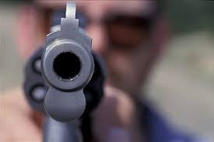
Act decisively, instantly
Act aggressively?
Know - two gunman have guns pointed a good gunman who’s gun is holstered. Know the good gun can step to side and put three rounds in the two gun man before they can get a round off
Gun to face - capture uke’s mind.
Practice this now as a group

Slide 21
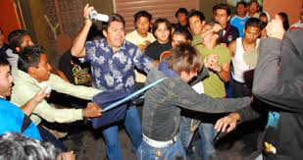
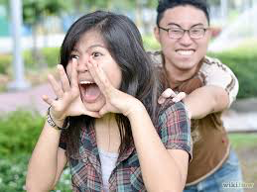
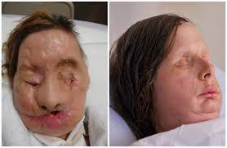
I give you permission
to defend yourself
to be rude when necessary
to survive no matter what
to always keep going

Slide 22
Afterwards
Get to save place
check yourself over
consider call 911
go over what you did and why - don’t second guess yourself or be brave. ‘i was very scared’ is fine to say.
Know when to ask for help.
However you feel is right
Don’t use this for secondary gain, be yourself

Slide 23
Afterwards
Show that the attacker had:
Intent: yelled ‘i will kill you’ or baggy clothes, shirt button at neck only, hanging free with bulge on R
Means: ‘i will shoot you’ but no gun then no means
Opportunity: ‘i will stab you’ but there is 100 ft gully...
That you felt threatened, tried to deescalate the situation, tried to get away and used only enough force to win (I could have hit him in the throat)

Slide 24
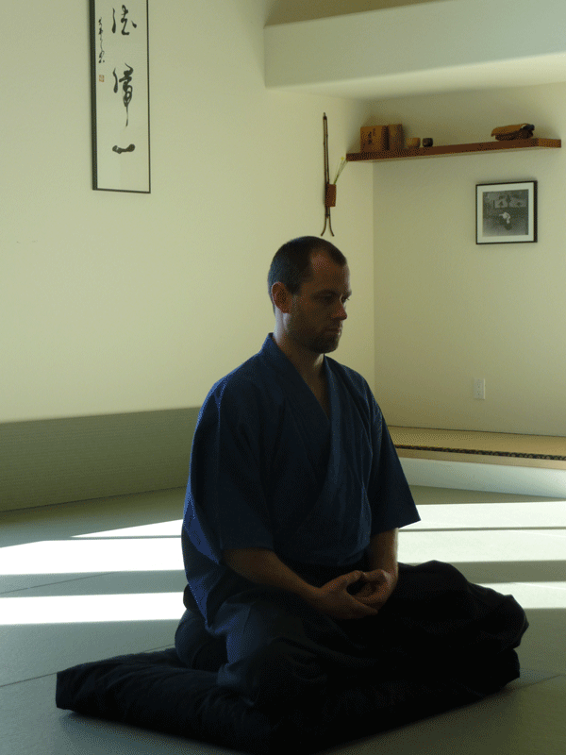
Keep in mind
Humans are not machines that need to be fixed but living organisms that grow in response to stress/ challenges.

Slide 25
Training
This is a separate talk but just some hints:
be in shape: aerobic & anaerobic - HIIT
read
solve scenarios, what if’s,
train in dojo -
make the fingers of the art serve your goshinjutsu
take all this and create YOUR personal practice
take responsibility for your own harmony, happiness

Slide 26
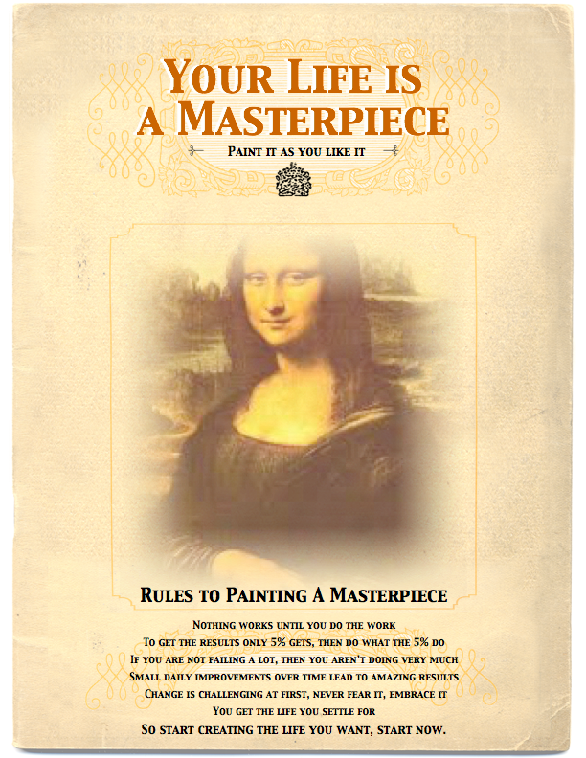

Slide 27
Thanks to:
Dr. Will Szlemco, Ph.D. - his readings and thoughts on the psychology of violence were very helpful. He is very sorely missed.
Rory Miller’s book: Mediations on Violence and Facing Violence are the best out there. Worth reading.
The many patients who present to the ER with their wounds secondary to violence.
Dr. Tim Vollmer for all his time and education in the medicine of ballistics and Tactical Medicine.

Slide 28
Questions?

Slide 29
Thank You for your time and attention!

